Slide 1

Geometry
Unit 9, Lesson 5 Cavalieri’s Principle Volume 2, pg. 76

Slide 2


Benchmark
MA.912.GR.4.5
Solve mathematical and real-world problems involving the volume of three-dimensional figures limited to cylinders, pyramids, prisms, cones, and spheres.
volume 2, pg. 76

Slide 3
Integrated Mathematical Thinking and Reasoning Standards
MA.K12.MTR.1.1 Actively participate in effortful learning both individually and collectively.
MA.K12.MTR.2.1 Demonstrate understanding by representing problems in multiple ways.
MA.K12.MTR.4.1 Engage in discussions that reflect on the mathematical thinking of self and others.
MA.K12.MTR.7.1 Apply mathematics to real-world contexts.
volume 2, pg. 76

Slide 4

Learning Target
I can use Cavalieri’s principle to give informal arguments about the formulas for the volumes of right and non-right cylinders, pyramids, prisms, and cones.
volume 2, pg. 76

Slide 5

Warm-Up
volume 2, pg. 76

Slide 6
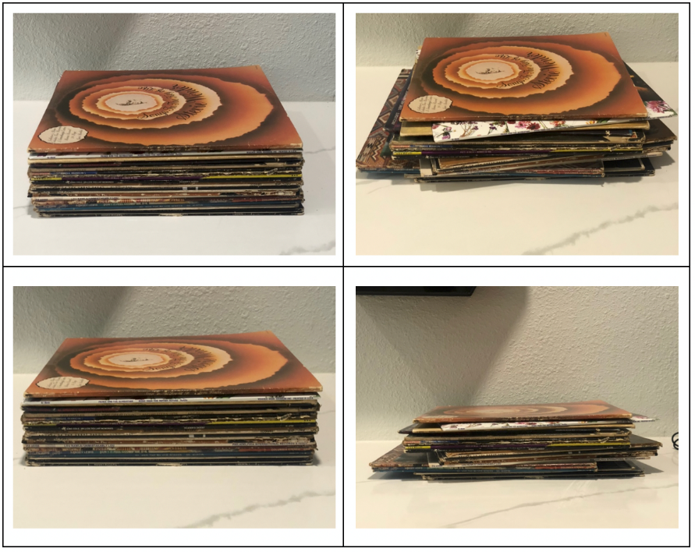
9.5.1 Warm-Up: Notice and Wonder
Four different perspectives of the same stack of records are shown.
volume 2, pg. 76

Slide 7
What do you notice?
What do you wonder?
volume 2, pg. 76

Slide 8

Collaboration
volume 2, pg. 77

Slide 9

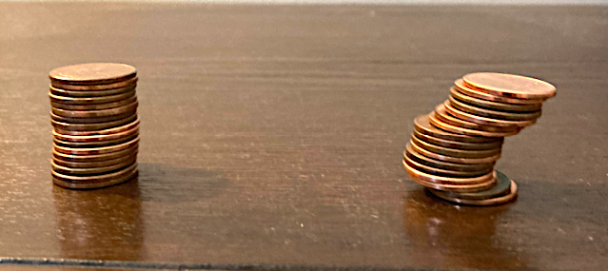
9.5.2 Collaboration: Exploring Cavalieri’s Principle
Scenario 1
Consider the two stacks of pennies, where each stack contains the same number of pennies. Discuss with your partner the relationship between the volumes of each stack.
volume 2, pg. 77

Slide 10
Summarize your discussion in the table below and have your partner initial that your summary is correct.
Summary | Partner’s Initials
volume 2, pg. 77

Slide 11
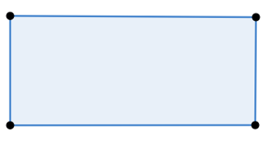
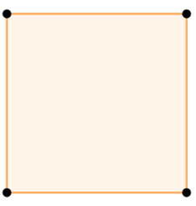
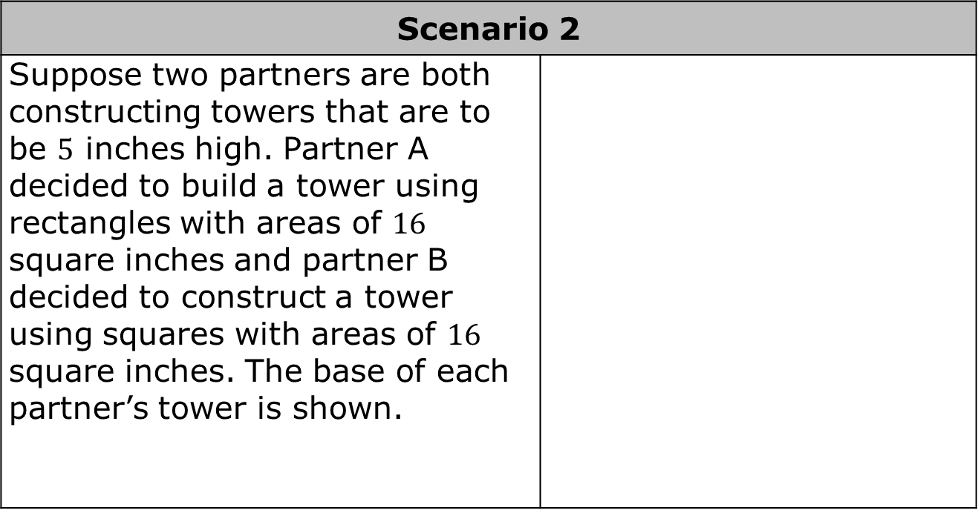
Scenario 2
Suppose two partners are both constructing towers that are to be $5$ inches high. Partner A decided to build a tower using rectangles with areas of $16$ square inches and partner B decided to construct a tower using squares with areas of $16$ square inches. The base of each partner’s tower is shown.
volume 2, pg. 77

Slide 12
Discuss with your partner how the volumes will compare. Summarize your findings in the box below and have your partner initial that your summary is correct.
Summary | Partner’s Initials
volume 2, pg. 77

Slide 13

Scenario 3
ABC ice cream shop decided to run a special for the week and they’re offering two serving options for you to choose from. Option 1 is a cone with a circular base that has an area of $4π$ square inches and a height of $4$ inches. Option 2 is a triangular pyramid container with a base of $4π$ square inches and a height of $4$ inches. The base of each option is shown.
volume 2, pg. 78

Slide 14
Discuss with your partner how the volumes will compare to one another. Summarize your findings in the box below and have your partner initial that your summary is correct.
Summary | Partner’s Initials
volume 2, pg. 78

Slide 15

Guided Instruction
volume 2, pg. 78

Slide 16

9.5.3 Guided Instruction: Cavalieri’s Principle
Cavalieri’s Principle for Three- Dimensional Solids
If every plane parallel to the two bases of two solids results in cross sections of equal area and the two solids have congruent altitudes, then the solids have equal volumes.
volume 2, pg. 78

Slide 17
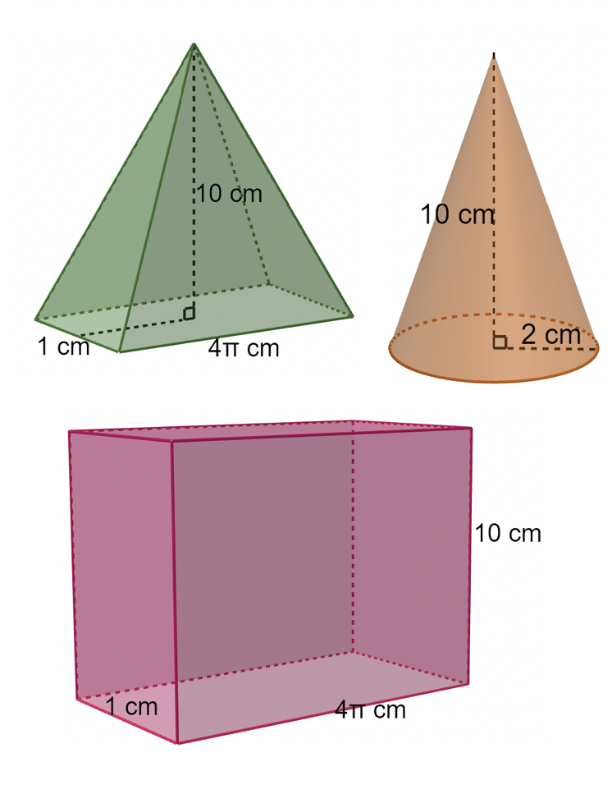
Using Cavalieri’s Principle, determine whether or not the following solids have the same volumes.
volume 2, pg. 78

Slide 18
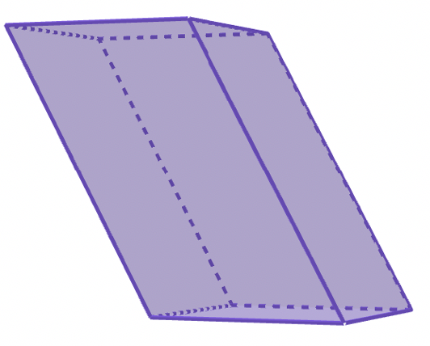
An oblique prism is shown.
What shape is each cross-section of the oblique prism?
What is the area formula for the base?
What is the volume formula for an oblique rectangular prism?
Discuss with your partner how the formula for the oblique rectangular prism compares to the formula for a right rectangular prism. Explain your reasoning.
volume 2, pg. 79

Slide 19
Guided Instruction
volume 2, pg. 79

Slide 20
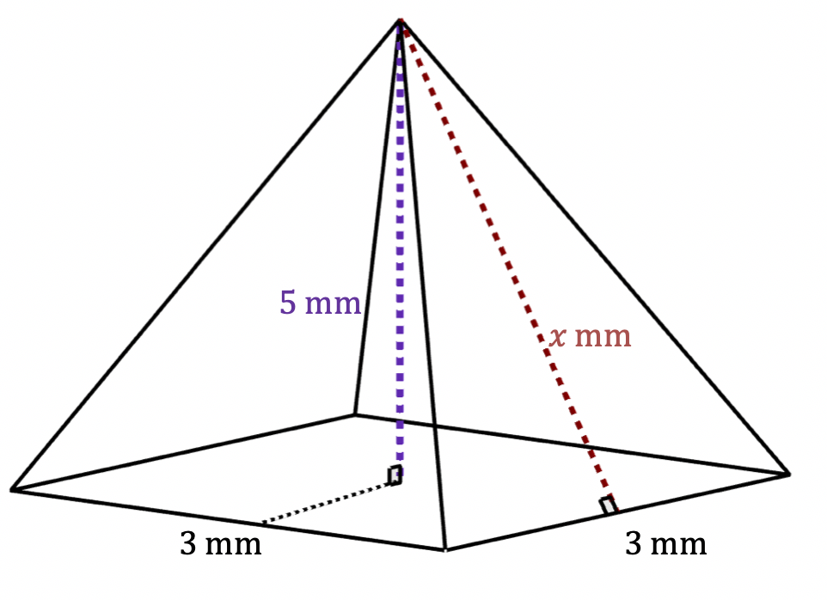
9.5.4 Guided Instruction: Slant Height vs. Vertical Height
A square pyramid is shown with measurements in millimeters (mm).
volume 2, pg. 79

Slide 21
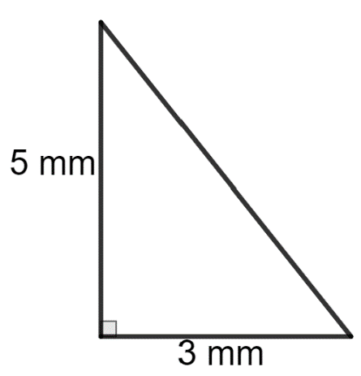
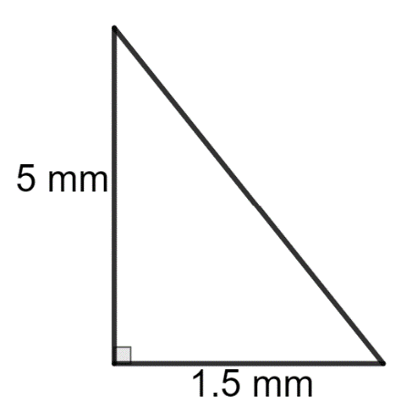
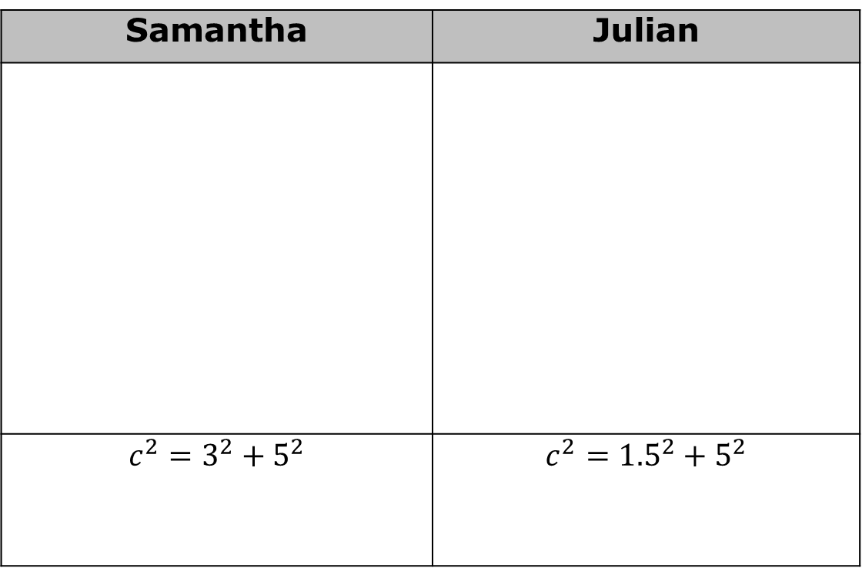
Samantha and Julian each found the measure of the slant height, $x$, by first drawing a diagram and then applying the Pythagorean Theorem. Their work is shown.
Samantha | Julian
$$c^{2}=3^{2}+5^{2}$$ | $$c^{2}={1.5}^{2}+5^{2}$$
volume 2, pg. 79

Slide 22
Discuss with your partner which student correctly set up their work to determine the slant height. Summarize your discussion.
Discuss with your partner which height is important when finding the volume of an oblique figure. Summarize your discussion.
The slant height of an object is the distance from the base to the apex along a lateral face, whereas the vertical height or altitude of an object is the perpendicular distance from the apex to the base.
volume 2, pg. 80

Slide 23

Guided Practice
volume 2, pg. 80

Slide 24

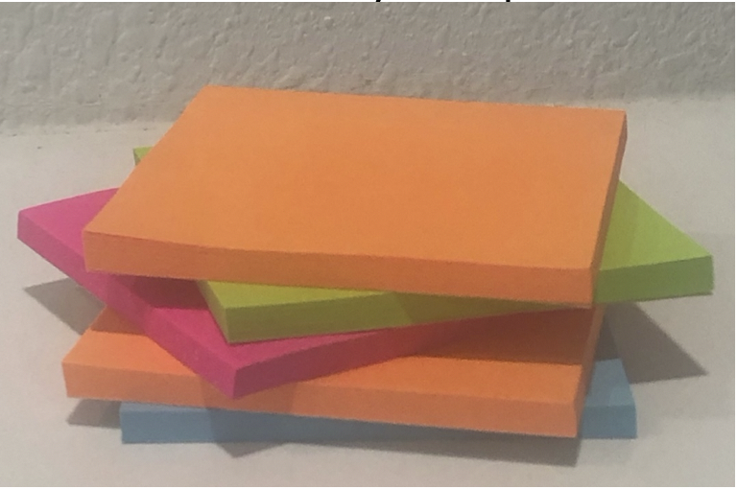

9.5.5 Guided Practice: Cavalieri’s Principle in the Real World
Consider the stack of sticky note pads below.
If each pad is a square with side lengths of $3$ inches and a height of $0.97$ inches, approximate the volume of a stack of $8$ sticky note pads.
volume 2, pg. 80

Slide 25
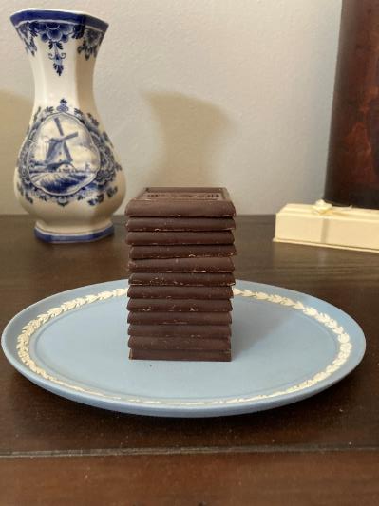
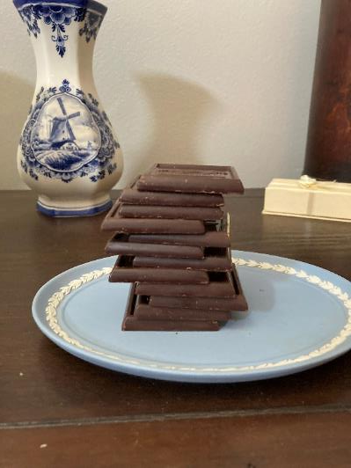
Two stacks of $12$ chocolate squares are shown.
Stack A | Stack B
volume 2, pg. 81

Slide 26
Each chocolate square has the dimensions $1\frac{5}{8}$ inches (in.) by $1\frac{5}{8}$ in. Each square is $\frac{1}{8}$ in thick. Find the volume of each stack.
Stack A | Stack B
volume 2, pg. 81

Slide 27
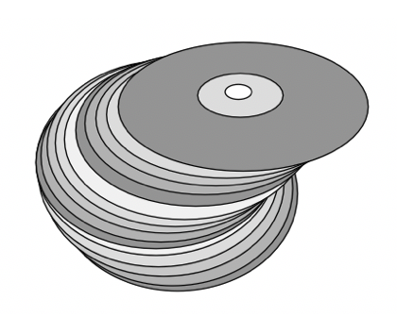
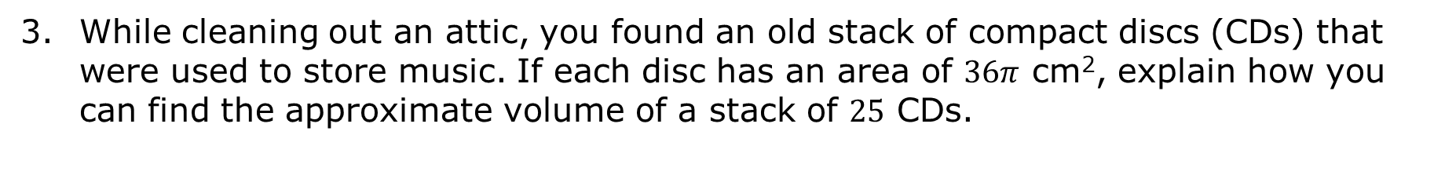
While cleaning out an attic, you found an old stack of compact discs (CDs) that were used to store music. If each disc has an area of $36π$ cm², explain how you can find the approximate volume of a stack of $25$ CDs.
volume 2, pg. 81

Slide 28
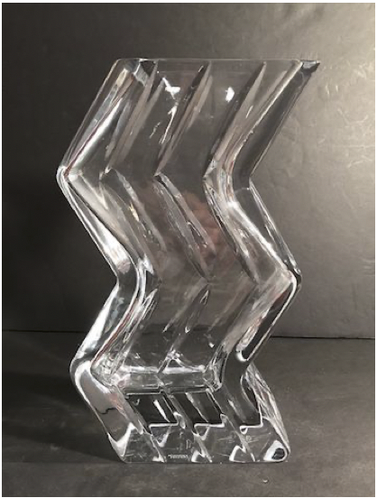
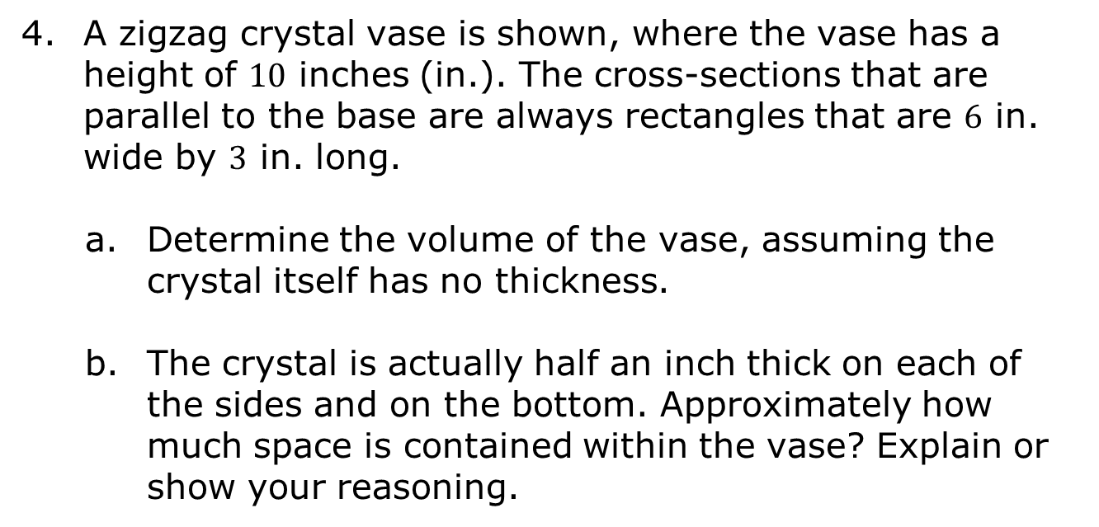
A zigzag crystal vase is shown, where the vase has a height of $10$ inches (in.). The cross‑sections that are parallel to the base are always rectangles that are $6$ in. wide by $3$ in. long.
Determine the volume of the vase, assuming the crystal itself has no thickness.
The crystal is actually half an inch thick on each of the sides and on the bottom. Approximately how much space is contained within the vase? Explain or show your reasoning.
volume 2, pg. 81

Slide 29

Wrap-Up
volume 2, pg. 82

Slide 30
9.5.6 Wrap-Up: Cool Down
Write a summary of what you learned in this lesson.
volume 2, pg. 82

